Slide 1
Open-source book New World Philosophy for You Evolve to Thrive Setting Foundations for the Upcoming Era of Evolving & Thriving Individuals & Societies www.newworldphilosophy.org

Slide 2
Why?
Throughout history, people's lives have been guided by a cacophony of often conflicting wisdom and religions focused on the next or afterlife. The result was persistent misery, violence, and suffering.
Now:
Standard of living is improving for many people.
Life is becoming easier, but ever more complex.
Alarmingly degradating natural environment.
Our number has jumped to 8 billion in very short time.
The circomstances have changed, but our mind hasn’t changed (enough).
The need for radical improvement in the quality of human thinking, functioning, and living is becoming ever more urgent. – The improvement is possible.

Slide 3
Searching for solution
The theories, hypotheses, religions, ideologies, techniques, and methods are countless, but the reality is one.
Can humanity step together, use the most competent method for proving the findings, and create one’s / the ultimate / world philosophy?
Is there one trigger / mechanism that can change humans? (The great majority of people will not meditate or practice other techniques.)
Is there already a process that just needs to be strengthened?

Slide 4
Just in time
Just at the time when this world is going to h...,
the solution has arrived.
What is it?
The world of social sciences has produced enough knowledge in recent years/decades that if synthesized together and offered to people as a philosophy it could save the world - as much as there is still to save.
Of course, the people would need to start living according to this philosophy.

Slide 5
New World Philosophy (NWP)
NWP is science-based thus reliable and trustworthy, neutral and acceptable by all.
NWP is well structured, which enables autonomous manoeuvering to anyone within this philosophical knowledge.
NWP is a holistic meta-theory exceeding partiality and subjectivism.
NWP focuses on paradigmatic change.
NWP is developmental describing the stages of individual and social development.
NWP is based on four cornerstones: freedom and empowerment, love and responsibility.
NWP explains the “true nature of reality” (Buddhism)
NWP is based on clear causal relationships (No misticism)
NWP is effective as it is based on knowledge about what really works.
NWP is clarifying in a world full of false assumptions and biased thinking.
NWP shares the excitement and passion for the life of consciousness development.
NWP is elegant.
NWP tries to be attractive to most people and purely positive for all.
NWP has the power to unite people.
NWP has the power to improve and possibly even save the world.
NWP brings hope and optimism.
NWP should be continuously improved that's why it is an open-source book/philosophy.
Join this transformative movement and shape a thriving, responsible world. Who, if not you? When, if not now?

Slide 6
CLEAR STRUCTURE - Vertical dimension: Development of Consciousness

Slide 7
So, we evolve...
...but why, when, who, what are the outcomes? Are only people at later (higher) stages really “good / well functioning” people?
Something is missing here.
Social scientists have observed a critical process for the last 43 years. Probably more important than vertical development. Very few people know about it. Probably the solution to most problems related to human beings.
The result: (Could be called) Culture of Love / Culture of Responsibility

Slide 8
Culture of Love / Culture of Responsibility
The result of liberation – Freedom, Democracy, Emancipation
Aren’t we free?
What are we liberating from?
How can we become more free?
What are the advantages & disadvantages of being free / not free?
What are the psychological consequences of liberation?
What are the psycho-social and cultural causes and consequences of freedom?
How to understand our moment in time / zeitgeist / state of existence?

Slide 9
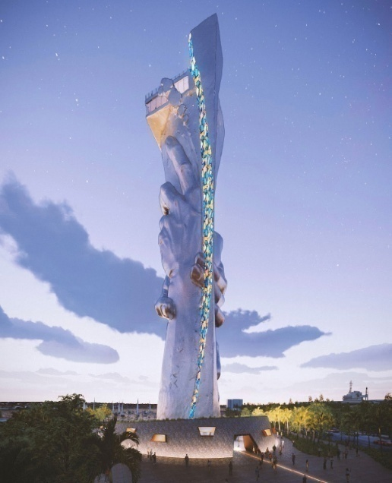
CLEAR STRUCTURE - Horizontal Dimension
From Victim Mentality to Culture of Responsibility / Culture of Love
The result of liberation, democratisation, emancipation
Steve Taylor – The Fall: Last 6000 years humanity is insane. – Pyramdal social structures – Profoundly wrong (Most people just self-absorbed)
For around 500 years humanity is in the process of liberation. With time delay - responsible too.
Last few decades (problematic last years) the process of liberation is mainly universal (all societies).
Only free, empowered, loving & responsible people are fully autonomous Humans. - Why?

Slide 10
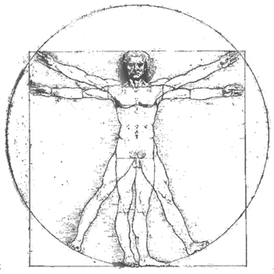
Humans – the creatures of needs
Self-Determination Theory: There exists a set of basic needs
Basic physiological needs (No satisfaction - death): air, water, food, sleep
Basic psychological needs (No satisfaction - frustrations):
Relatedness – The need to feel socially connected, belonging, being significant among others, caring for others, and being cared for by others
Autonomy – One’s behavior needs to be self-endorsed or congruent with one’s authentic interests and values.
Competence – The need to feel effectance and mastery

Slide 11
Humans – the creatures of needs (part 2)
I suggest that we see a human as the system of 3 subsystems:
Physiological
Psychological
Spiritual
I suggest the existence of 4 basic spiritual needs for:
Truth (novelty) – The need to understand the living environment (curiosity, love for learning)
Beauty – The need for everything to look, sound, taste good (partners - good genes, food - nutritious, living environment - stable, safe, comfortable, etc.)
Justice - The need for safe environment without violence of any kind.
Good – The need for everything in life to be of a good quality

Slide 12
What happens?
For the last 6000 years, (entry to RED) most people did not have their basic psychological needs satisfied. Is this why so many things were and still are so wrong in the world? This has been a huge human tragedy!
Satisfaction or deprivation of basic needs (BPN) has clear and measurable functional effects. (Crucial!) So, the way people function depends on the level of satisfaction of a basic set of needs.
They are objective phenomena. They need to be satisfied regardless person’s values, desires, or goals.
Satisfaction enables favorable psychological processes and a progressive mode of functioning.
Deprivation results in unfavorable psychological processes and a defiant mode of functioning. (Defiant? Doing things subversively – selfish/partial interest & undermining the objective interest.)
Our thinking systems, values, modes of functioning, cultures, etc. are still overly based on foundations of unsatisfied BPN.

Slide 13
Deprivation
The negative side - Thwarted basic needs result in unfavorable psychological processes and a defiant mode of functioning:
Perception of having lack of control over life. (Refusal of life as it is.)
Defensiveness - self-absorption, learned helplessness, and/or victim mentality (Not taking responsibility)
Low well-being, frustrations, and even trauma
Low self-regulation (Unpleasant behavior, addictions, etc.)
Weak internalization and integration process - Immunity to change
Extrinsic motivation (laziness)
Aggression - Achieving goals by the use of violence (physical, psych.)
Life strategies – continuous search for BN satisfaction at the wrong places: Motives for greed, power, etc. but no satisfaction ever found.
I suggest: Dysfunctional meaning-making process (the need for consolation – low objectivity, outer locus of control, use of a wider range of cognitive biases, illusions, and delusions, conspiratorial thinking – My misery is their fault. The need for revenge. Cause of evil.)

Slide 14
Satisfaction
On the positive side satisfaction enables favorable psychological processes and progressive mode of functioning:
Well-being
Intrinsic motivation
Perception of control over life
Important mechanism: Satisfaction of needs (hedonic principle – no decadence) guarantees vitality/willpower/strength “to go beyond ourselves” and behave as real characters – 24 character strengths (Eudaimonic principle)
Intensive internalization and integration processes lead to psychological development(!)
Good self-regulation (They do not exaggerate. People with unsatisfied BN exaggerate.)
I suggest: Less violent behavior
I suggest: More accurate explanation of life
The need for truth leads to higher objectivity.

Slide 15
Thinking system producing illusions, dellusions and evil – Meaning-making mechanism employed as a comforter
Unfulfilled basic psychological needs–frustrations
Perception of life as unmanageable – lack of control (I don’t like the life I live.)
Reinforcement of ego defense system (Lack of information)
Refusal of unwanted but crucial sources of information
Inhibited internalization and integration process
External locus of control–blaming others and abstract entities for misfortune (They are wrong! It is their fault! How can I tolerate them?)
Suspicious observation of what others and the powerful do (conspirational thinking)
By not blaming oneself, reduced the need for reflexivity (It is his/her/their fault. Case solved.)
Blurred causal relationship (Such is destiny. Everything happens for the reason. Etc.)
Use of a range of cognitive biases
Searching for self-consolation, not truth
Reduced flexibility of complexity of thinking
Low or extrinsic motivation
Poor self-regulation
Low mental complexity
Result: more selfishness, higher violence, poorer quality activity, or no activity (learned helplessness)
From mild to strong form of victim mentality.
Thousands of years of religious zeal and evil cohabitation. (Many people’s life is still hard and they need consolation.)

Slide 16
New World Philosophy thinking system
Fulfilled basic psychological needs
Perception of life as manageable – control over life
A healthy ego defense system
Strength (vitality) to go beyond oneself–eudemonic principle
Openness to wider range of information (better awareness)–curiosity and love for learning (strengths)
Intensive internalization and integration process
Internal locus of control–believing that one can control one's own life
Trusting that all people are basically good and just want to live well and be happy
Negative feedback boosts the need for reflexivity
Searching for truth
Better awareness of cognitive biases
Understanding causal relationships thoroughly
Rationality in judgment
Highly flexible/complex thinking
Intrinsic motivation
Good self-regulation
Result: Common sense, transparency, mental hygiene, etc. Activities focused on producing a good, just, beautiful, and high-quality reality (Violence and evil can be reduced to a minimum.)

Slide 17
The Conditions
Freedom, (3 levels of liberation: structural, cultural, intrinsic) democracy, and functioning institutions enable a favorable environment for the satisfaction of the basic psychological need for autonomy. LL for UL
Equality enables a favorable environment for the satisfaction of basic psychological needs for relatedness. (Autonomy-supportive behavior emerges.) LL & UR for UL
Legal order, economic freedom, social state, and functioning institutions, enable a favorable environment for the satisfaction of basic psychological need for competence (acting brings results) LL & LR for UL
All four quadrants affect each other.
In short: Good, democratic, supportive living conditions guarantee a higher chance of satisfaction of BPN and BSN. Satisfied people function in a way capable of co-creating a better world.

Slide 18
The process
Liberal, democratic and emancipative environment enables better satisfaction of BPN (hedonic principle)
what enables favorable psychological, psycho-social processes and favorable cultural processes (eudaimonic principle)
Well functioning people contribute to thriving society (across practiaclly all measurable categories)
The thriving society enables better satisfaction of spiritual needs (hedonic principle). People can cumulate resources – knowledge (education), material, financial and other, they take important positions. In the process they exchange extrinsic values for intrinsic ones.
The above mentioned process enables vertical development
All four quadrants affect each other.

Slide 19
Favorable cultural processes?
According to www.worldvaluessurvey.org in the process of gaining emancipative values (as a result of liberation) the following categories develop exponentially:
Trust
Unselfishness
Humanistic orientation
What is the common denominator of these 3 categories?
I suggest: Introduction of the principle/concept of “Love”.
In what sense? The closest to the Greek concept called Agape. It is about the state of mind generating a favorable attitude towards extrinsic and intrinsic reality. It is the result of favorable psychological processes, resulting from satisfaction of BP,P,SN. It is not romantic or sexual. It should become the foremost guideline for humanity.
What people internalize and integrate into reality schema, becomes “part of them” – new meaning. This is what they love and consequently treat with responsibility (care, tolerance, benevolence, in a virtuous way, with understanding, etc.) This leads to the Self-Transforming mind.
A society of loving and responsible people can form a Culture of responsibility.
Christian Welzel in the book Freedom Rising proves that people with highly emancipative values treat natural environment better (everything else too).

Slide 23
Culture of Responsibility
Important: By gaining emancipative values (as a result of liberation) people start functioning ever more optimally with exponential dynamics.
At a certain point, the 180-degree shift occurs. It changes the quality of communication and behavior, which in turn changes the culture in a society. Communication becomes non-violent as Marshal Rosenberg described it. The basic components of this type of communication are awareness of one's own needs and letting autonomy in decision-making. So person A does not even kindly ask person B for a favor, but rather just tells what she or he needs and person B autonomously offers a supportive solution or help.
This has multiple positive consequences (not all mentioned here). It changes people’s mindsets, communication, way of living and working, culture, functioning of economies and public sector, and the way they treat the cultural and natural environment.
It changes societies across all measurable and obviously also immeasurable categories: GDP, Social Development Index, Trust Index, Corruption Index (inverse), Happines Index, Innovation index, Environmental Performance Index, etc.
Much longer explanation needed!

Slide 24
Conclusion
Freedom X Power + Responsibility X Love = Development of Consciousness
Freedom – Responsibility = Unsustainablity
Thank You for Your Attention!
Trust people!
P.S: I appreciate any help or advise regarding New World Philosophy book/project.

