Slide 1
Nurturing the Fields of Change: A community of practice and programme serving holistic change facilitation …living the questions, dancing with uncertainties, honouring emergence, and restoring relations. https://www.fieldsofchange.org
Jessica Bockler, PhD

Slide 2
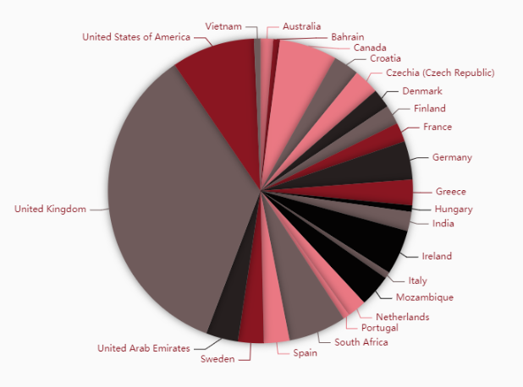
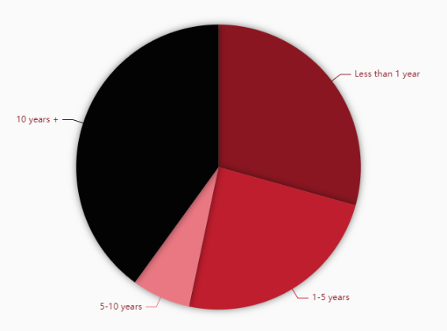
Nurturing the Fields of Change: An evolving community of practice
How much experience do you have in change facilitation?
Where are you based?
Sample size: 150

Slide 3
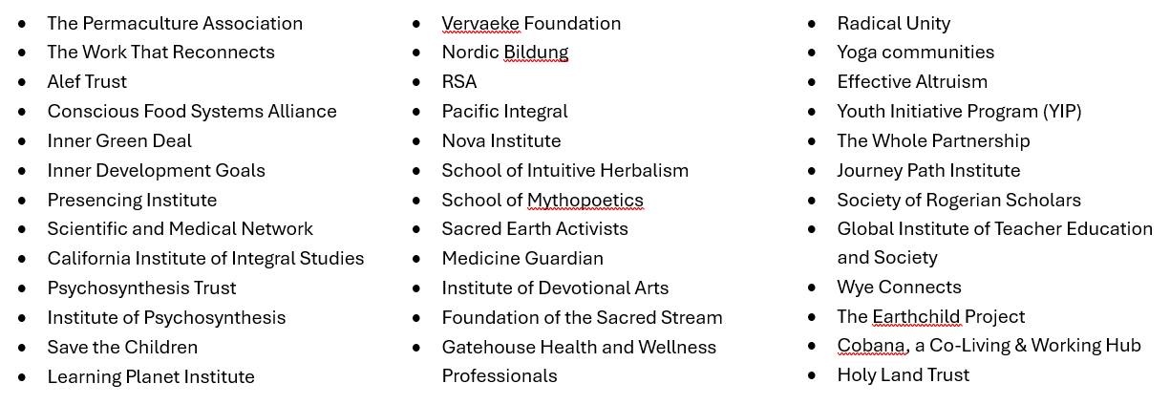
Nurturing the Fields of Change: An evolving community of practice
Which organisations, communities and networks are you connected to?

Slide 4
Nurturing the Fields of Change: An evolving community of practice
The desire for communion, reciprocity & manifestation
When asked what participants wanted from this community and what they could give to it, very similar themes emerged, highlighting overarching aspirations and desires for reciprocity, accompaniment and collaborative action:
Be in connection and community
Be in well held spaces, to enable deep, authentic dialogue
Receive and give inspiration
Receive and give practical, moral and emotional support
Engage in collaboration and co-creation

Slide 5
Nurturing the Fields of Change: An evolving community of practice
The challenges we face
Many of us …
… deal with a lot of complexity & uncertainty
… are time-poor
… navigate resource constraints
… navigate delicate relationships & power dynamics
… find it hard to share deep experiences in existing circle … feel shy to share failure & unsure where we can place trust … feel vulnerable about our spiritual perspectives … experience scattered attention across projects & networks
We come together to transform our individual & collective potential.

Slide 6
Dixon, L. J., Hornsey, M. J., & Hartley, N. (2025). “The Secret” to Success? The Psychology of Belief in Manifestation. Personality and Social Psychology Bulletin, 51(1), 49-65. https://doi.org/10.1177/01461672231181162
“The Secret” to Success?
Three studies (collective N = 1,023),
Developed validated measure: the Manifestation Scale
Findings:
35% of participants endorsed manifestation beliefs.
Those who scored higher on the scale perceived themselves as more successful, had stronger aspirations for success, and believed they were more likely to achieve future success.
They were also more likely to be drawn to risky investments, have experienced bankruptcy, and to believe they could achieve an unlikely level of success more quickly.

Slide 7
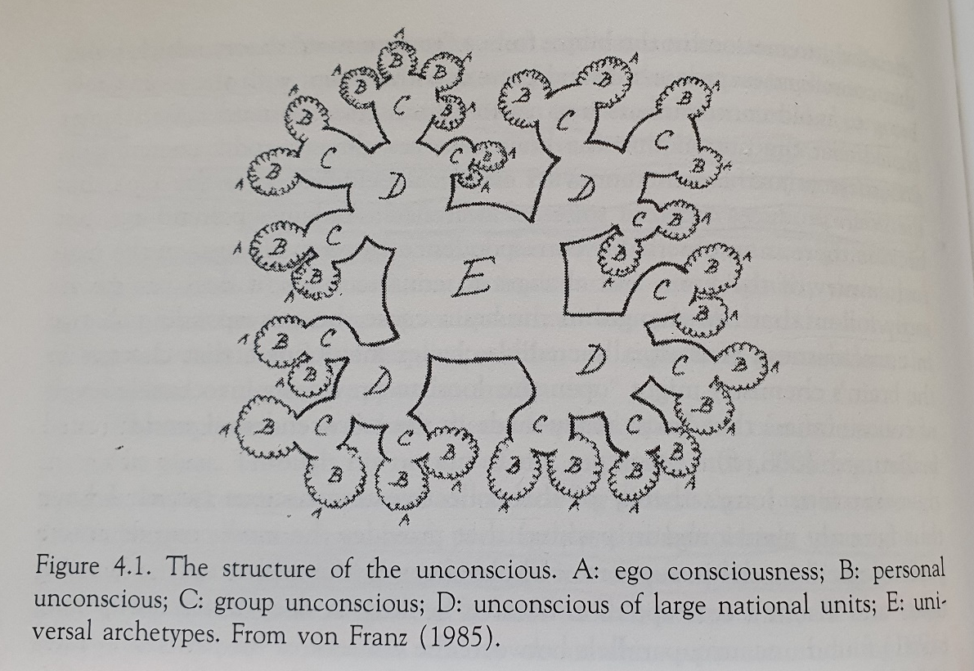
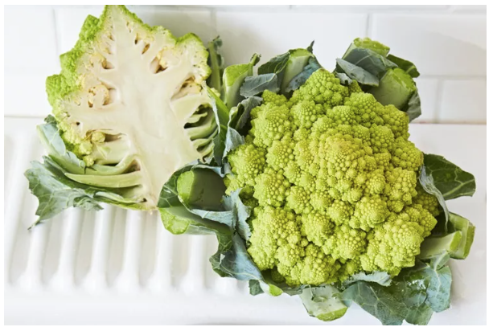
Fields of Consciousness
Bockler, J. (2022). Group Coherence: Its Shadow and Its Generative Potential. Journal of Awareness-Based Systems Change, 2(2), 173–182. https://doi.org/10.47061/jasc.v2i2.5059
Nicol, D. (2015). Subtle activism. SUNY Press (p. 150).

Slide 8
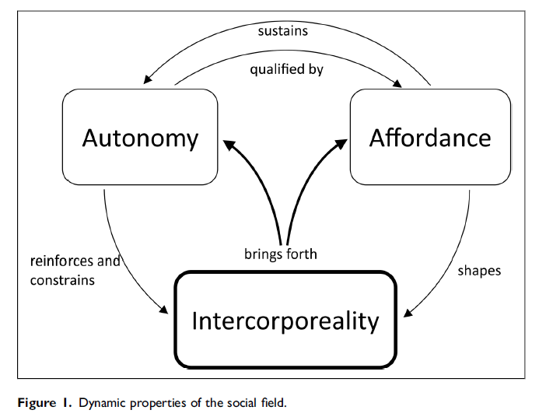
Fields of Consciousness
Pomeroy, E., & Herrmann, L. (2024). Social Fields: Knowing the Water We Swim in. The Journal of Applied Behavioral Science, 60(4), 677-700. https://doi.org/10.1177/00218863231174957

Slide 9
Generative patterns for a generative future
For Practitioners
Begin with being
Clarify your intentions: Attention & actions follow intention
Attend to all your intelligences
Start small, prototype and iterate
Remember self-care
Practice active receptivity
Witness the whole
Notice the acupuncture points in a system
Pause in the gaps, fissures & tensions
Befriend limitations
Bockler, J. & Hector, F. (2022). Nurturing the fields of change: An inquiry into the living dynamics of holistic change facilitation. Alef Trust.

Slide 10
Generative patterns for a generative future
For Policy Makers & Funders & Organisations
Consider roles and skills across a team
Consider team sustenance to avoid burn-out, fall-out and drop-out
Undertake holistic needs assessments
Enable organic project emergence & growth
Expect and welcome unforeseen outcomes
Welcome failure as learning
Support long-term vision
Cultivate epistemic and axiological flexibility
Place emphasis on wellbeing and care
Embrace stakeholder governance
Bockler, J. & Hector, F. (2022). Nurturing the fields of change: An inquiry into the living dynamics of holistic change facilitation. Alef Trust.

Slide 11
“Cultural change can be catalysed by the creation of cultural fractals that display essential characteristics of the preferred cultural condition.”
(Paul Downton, 2012)

Slide 12
